Slide 1

CSE 473
Pattern Recognition

Slide 2
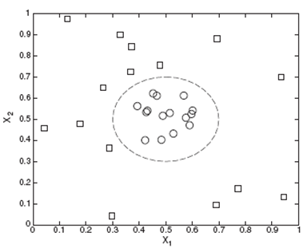
Nonlinear Classifier

Slide 3

Review of Perceptron’s Capability
Recall the AND or OR functions
x₁ | x₂ | AND |  | OR
0 | 0 | 0 |  | 0
0 | 1 | 0 |  | 1
1 | 0 | 0 |  | 1
1 | 1 | 1 |  | 1

Slide 4
Review of Perceptron’s Capability
Recall the AND or OR functions
x₁ | x₂ | AND | Class | OR | Class
0 | 0 | 0 | B | 0 | B
0 | 1 | 0 | B | 1 | A
1 | 0 | 0 | B | 1 | A
1 | 1 | 1 | A | 1 | A

Slide 5
Review of Perceptron’s Capability
Can you remember the perceptron’s capability to separate them?
x₁ | x₂ | AND | Class | OR | Class
0 | 0 | 0 | B | 0 | B
0 | 1 | 0 | B | 1 | A
1 | 0 | 0 | B | 1 | A
1 | 1 | 1 | A | 1 | A

Slide 6
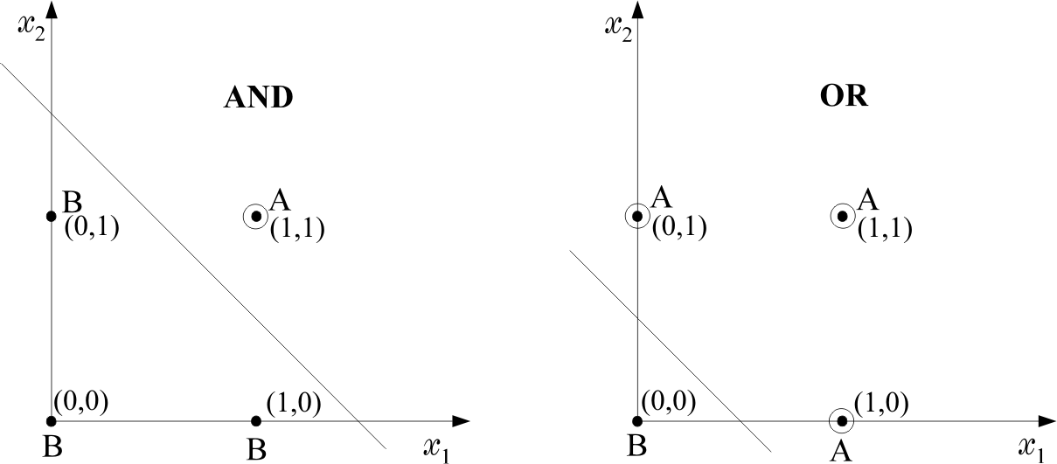
Review of Perceptron’s Capability

Slide 7
Review of Perceptron’s Capability

Slide 8
Review of Perceptron’s Capability
x₁ + x₂ -1/2 =0
x₁
1
x₂
1
-1/2

Slide 9
Review of Perceptron’s Capability
x₁ + x₂ -3/2 =0
x₁
1
1
x₂
-3/2

Slide 10
Review of Perceptron’s Capability
x₁ | x₂ | XOR | Class
0 | 0 | 0 | B
0 | 1 | 1 | A
1 | 0 | 1 | A
1 | 1 | 0 | B
Now recall the XOR function

Slide 11
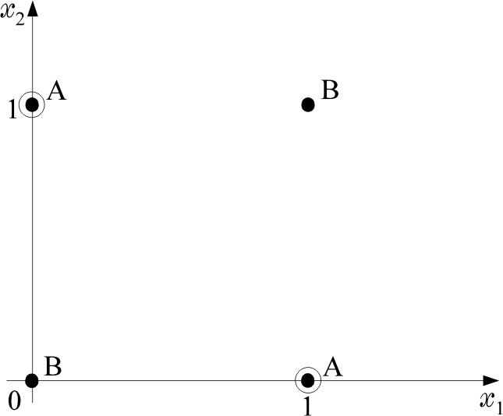
Review of Perceptron’s Capability
x₁ | x₂ | XOR | Class
0 | 0 | 0 | B
0 | 1 | 1 | A
1 | 0 | 1 | A
1 | 1 | 0 | B
Now recall the XOR function

Slide 12
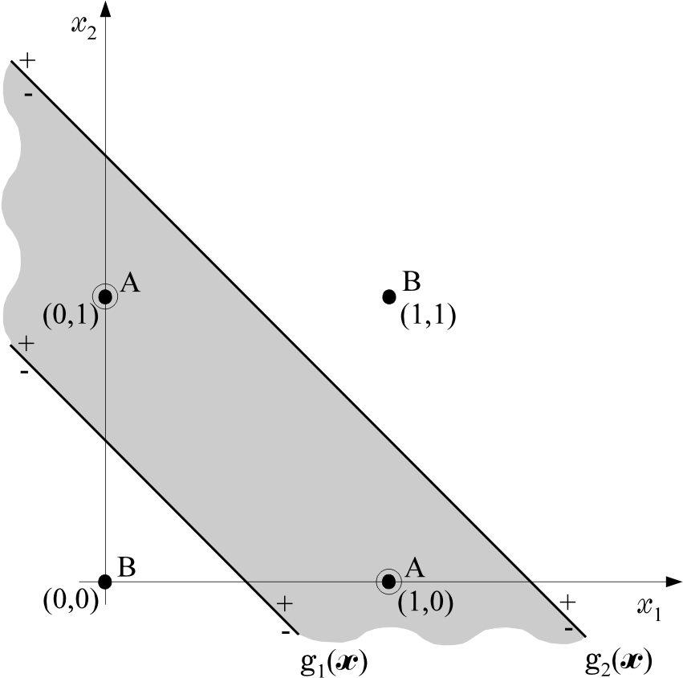
Review of Perceptron’s Capability
For the XOR problem, draw two lines instead of one

Slide 13
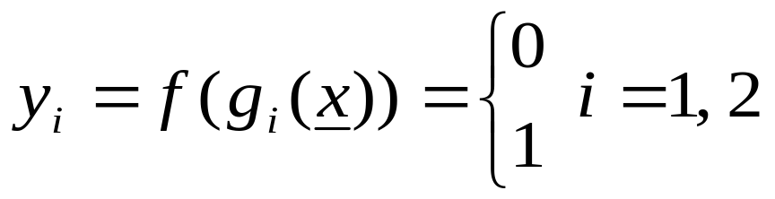
Review of Perceptron’s Capability
B
A
g₂(x)
g₁(x)
B
Each of them is realized by a perceptron.
Find the position of x w.r.t. both lines, based on the values of y₁, y₂.

Slide 14
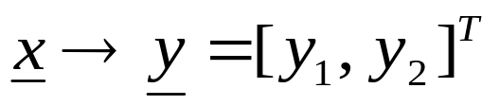
Review of Perceptron’s Capability
1st phase
x₁ | x₂ | y₁ | y₂
0 | 0 | - | -
0 | 1 | + | -
1 | 0 | + | -
1 | 1 | + | +
Equivalently: The computations of the first phase perform a mapping

Slide 15
Review of Perceptron’s Capability
1st phase
x₁ | x₂ | y₁ | y₂
0 | 0 | 0(-) | 0(-)
0 | 1 | 1(+) | 0(-)
1 | 0 | 1(+) | 0(-)
1 | 1 | 1(+) | 1(+)
Equivalently: The computations of the first phase perform a mapping

Slide 16
Review of Perceptron’s Capability
1st phase
x₁ | x₂ | y₁ | y₂
0 | 0 | 0 | 0
0 | 1 | 1 | 0
1 | 0 | 1 | 0
1 | 1 | 1 | 1
Equivalently: The computations of the first phase perform a mapping

Slide 17
Review of Perceptron’s Capability
1st phase |  |  |  | 2nd phase
x₁ | x₂ | y₁ | y₂
0 | 0 | 0 | 0 | B(0)
0 | 1 | 1 | 0 | A(1)
1 | 0 | 1 | 0 | A(1)
1 | 1 | 1 | 1 | B(0)
Equivalently: The computations of the first phase perform a mapping

Slide 18
Review of Perceptron’s Capability
1st phase |  |  |  | 2nd phase
x₁ | x₂ | y₁ | y₂
0 | 0 | 0 | 0 | B(0)
0 | 1 | 1 | 0 | A(1)
1 | 0 | 1 | 0 | A(1)
1 | 1 | 1 | 1 | B(0)
Now classify based on [y₁, y₂]

Slide 19

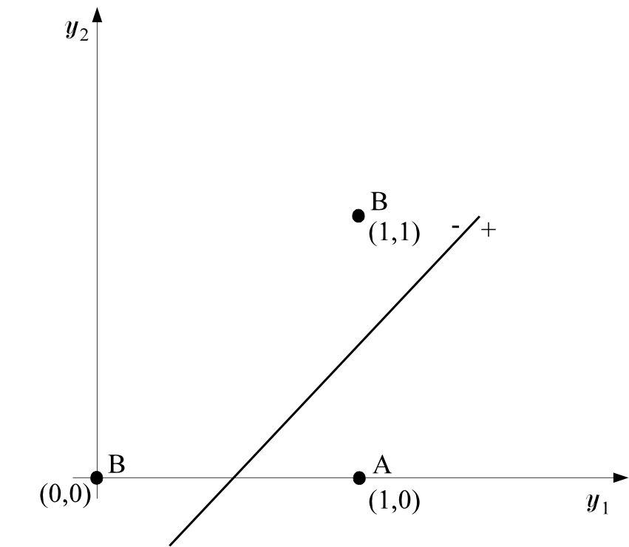

Review of Perceptron’s Capability
The decision is now performed on the transformed data.
This can be performed via a second line, which can also be realized by a perceptron.

Slide 20
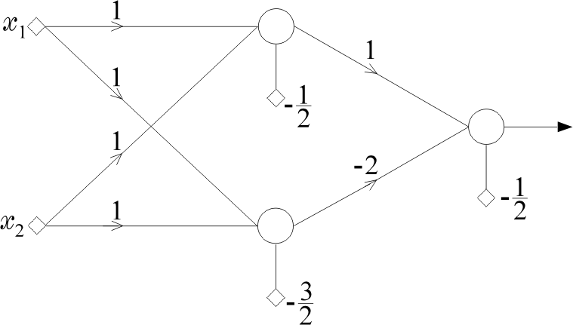
Two phases, Two Layers
Computations of the first phase perform a mapping that transforms the nonlinearly separable problem to a linearly separable one.
The architecture

Slide 21
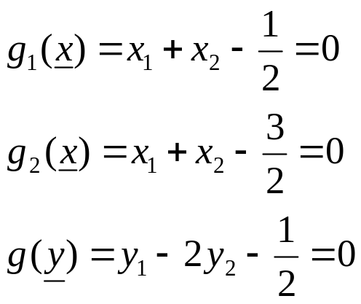
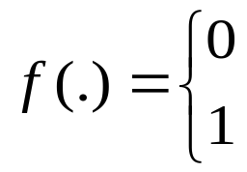
Two Layer Perceptron
hidden layer
output layer
nodes realizes hyper planes:
Activation function:

Slide 22
Classification Capabilities of Two Layer Perceptron
The mapping performed by the first layer neurons is onto the vertices of the unit side square, e.g.,
(0, 0), (0, 1), (1, 0), (1, 1).

Slide 23
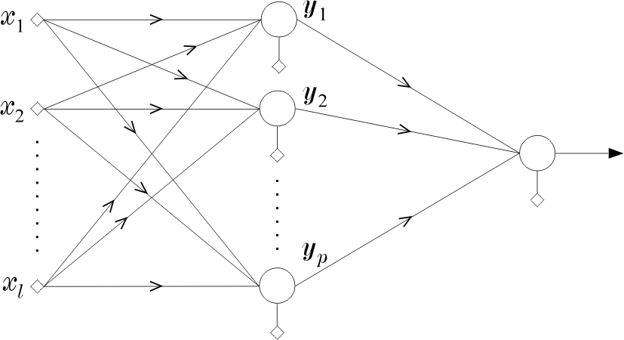
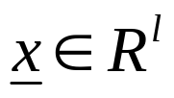
Classification Capabilities of Two Layer Perceptron
Consider a more general case,

Slide 24
Classification Capabilities of Two Layer Perceptron
maps a vector onto the vertices of the unit side hypercube, Hp
mapping is through p neurons each realizing a hyper plane.
The output of each of these neurons is 0 or 1

Slide 25
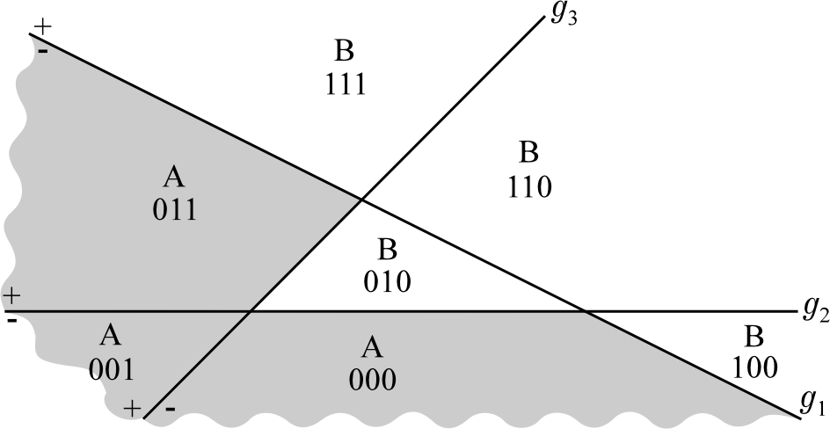
Classification Capabilities of Two Layer Perceptron
Intersections of hyperplanes form regions.
Polyhedral region

Slide 26
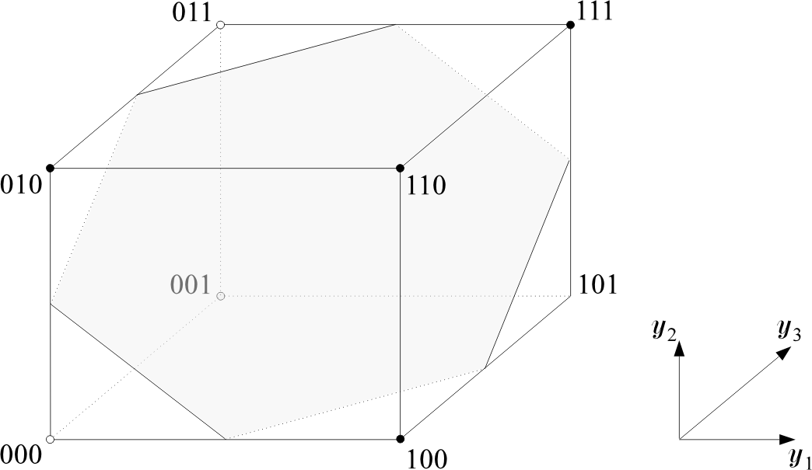
Classification Capabilities of Two Layer Perceptron
Intersections of hyperplanes form regions.
Each region corresponds to a vertex of the H_{p} unit hypercube.

Slide 27
Classification Capabilities of Two Layer Perceptron
For example, the 001 vertex corresponds to the region which is located
to the (-) side of g₁ (x)=0
to the (-) side of g₂ (x)=0
to the (+) side of g₃ (x)=0

Slide 28
Classification Capabilities of Two Layer Perceptron
011
A
001
A
A
A two-class problem
  Class A patterns from regions marked as A
  Class B patterns from regions marked as B

Slide 29
Classification Capabilities of Two Layer Perceptron
011
A
001
A
A
The output neuron
  realizes another hyperplane
  separates the hypercube.
  can classify vectors consisting of some unions of polyhedral regions.

Slide 30
Classification Capabilities of Two Layer Perceptron
A
A
001
A
A

Slide 31
Classification Capabilities of Two Layer Perceptron
A
001
A
A
A
The output neuron, i.e., a 2 layer perceptron
  cannot classify vectors consisting of arbitrary unions of polyhedral regions.

Slide 32
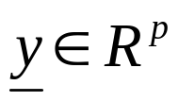
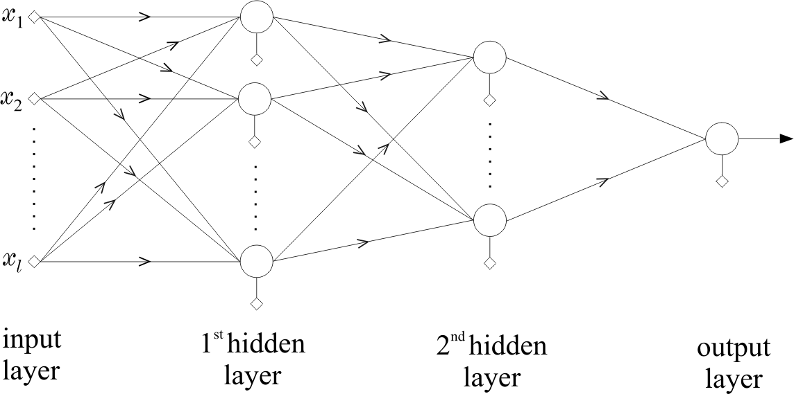
Solution: Three Layer Perceptron
capable to classify vectors consisting of ANY union of polyhedral regions.
  The idea is similar to the XOR problem.
  Realizes more than one planes in the space.
1
1
2
q
p

Slide 33
How does The Three Layer Perceptron Do It?
Let, any J polyhedral regions constitutes vectors of class A.
Learn a neuron in the 2nd hidden layer for each of J regions
1
1
2
J
p

Slide 34
How does The Three Layer Perceptron Do It?
Learn a neuron in the 2nd hidden layer for each of J regions
A
1
A
A
J
A

Slide 35
How does The Three Layer Perceptron Do It?
For training vectors of a particular region of class A, only one of the 2^{nd-}layer neuron produces 1, the rest of neurons produce 0.
Now realize the output neuron as an OR gate.
1
1
2
J
p

Slide 36
Training of a Multi Layer Perceptron (MLP)
use rationale and develop a structure that classifies correctly all the training patterns.
OR
choose a structure and compute the synaptic weights to optimize a cost function.
(L-1)^{th}
Lth or

Slide 37
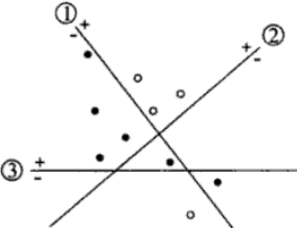
Algorithm Based on Exact Classification of Training Examples
x₂
x₁

Slide 38
Algorithm Based on Exact Classification of Training Examples
x₂
1
x₁
x₂
x₁

Slide 39
Algorithm Based on Exact Classification of Training Examples
x₂
1
2
x₁
x₂
x₁

Slide 40
Algorithm Based on Exact Classification of Training Examples
x₂
1
2
3
x₁
x₂
x₁

Slide 41
Algorithm Based on Exact Classification of Training Examples
x₂
Master unit
Ancillary units
1
2
3
x₁
x₂
x₁

Slide 42
Algorithm Based on Exact Classification of Training Examples
x₂
1
2
3
x₁
x₂
x₁

Slide 43
Algorithm Based on Exact Classification of Training Examples
x₂
y₁
y₂
y₃
1
2
3
x₁
x₂
x₁

Slide 44
Algorithm Based on Exact Classification of Training Examples
y₂
y₁
y₂
y₃
1
2
3
y₁
x₁
x₂
y₃

Slide 45
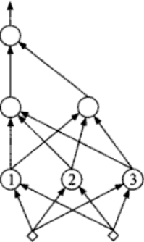
Algorithm Based on Exact Classification of Training Examples
y₂
y₁
y₁
y₂
y₃
x₁
x₂
y₃

Slide 46
Algorithm Based on Exact Classification of Training Examples
x₂
x₁
x₂
x₁

